Slide 1
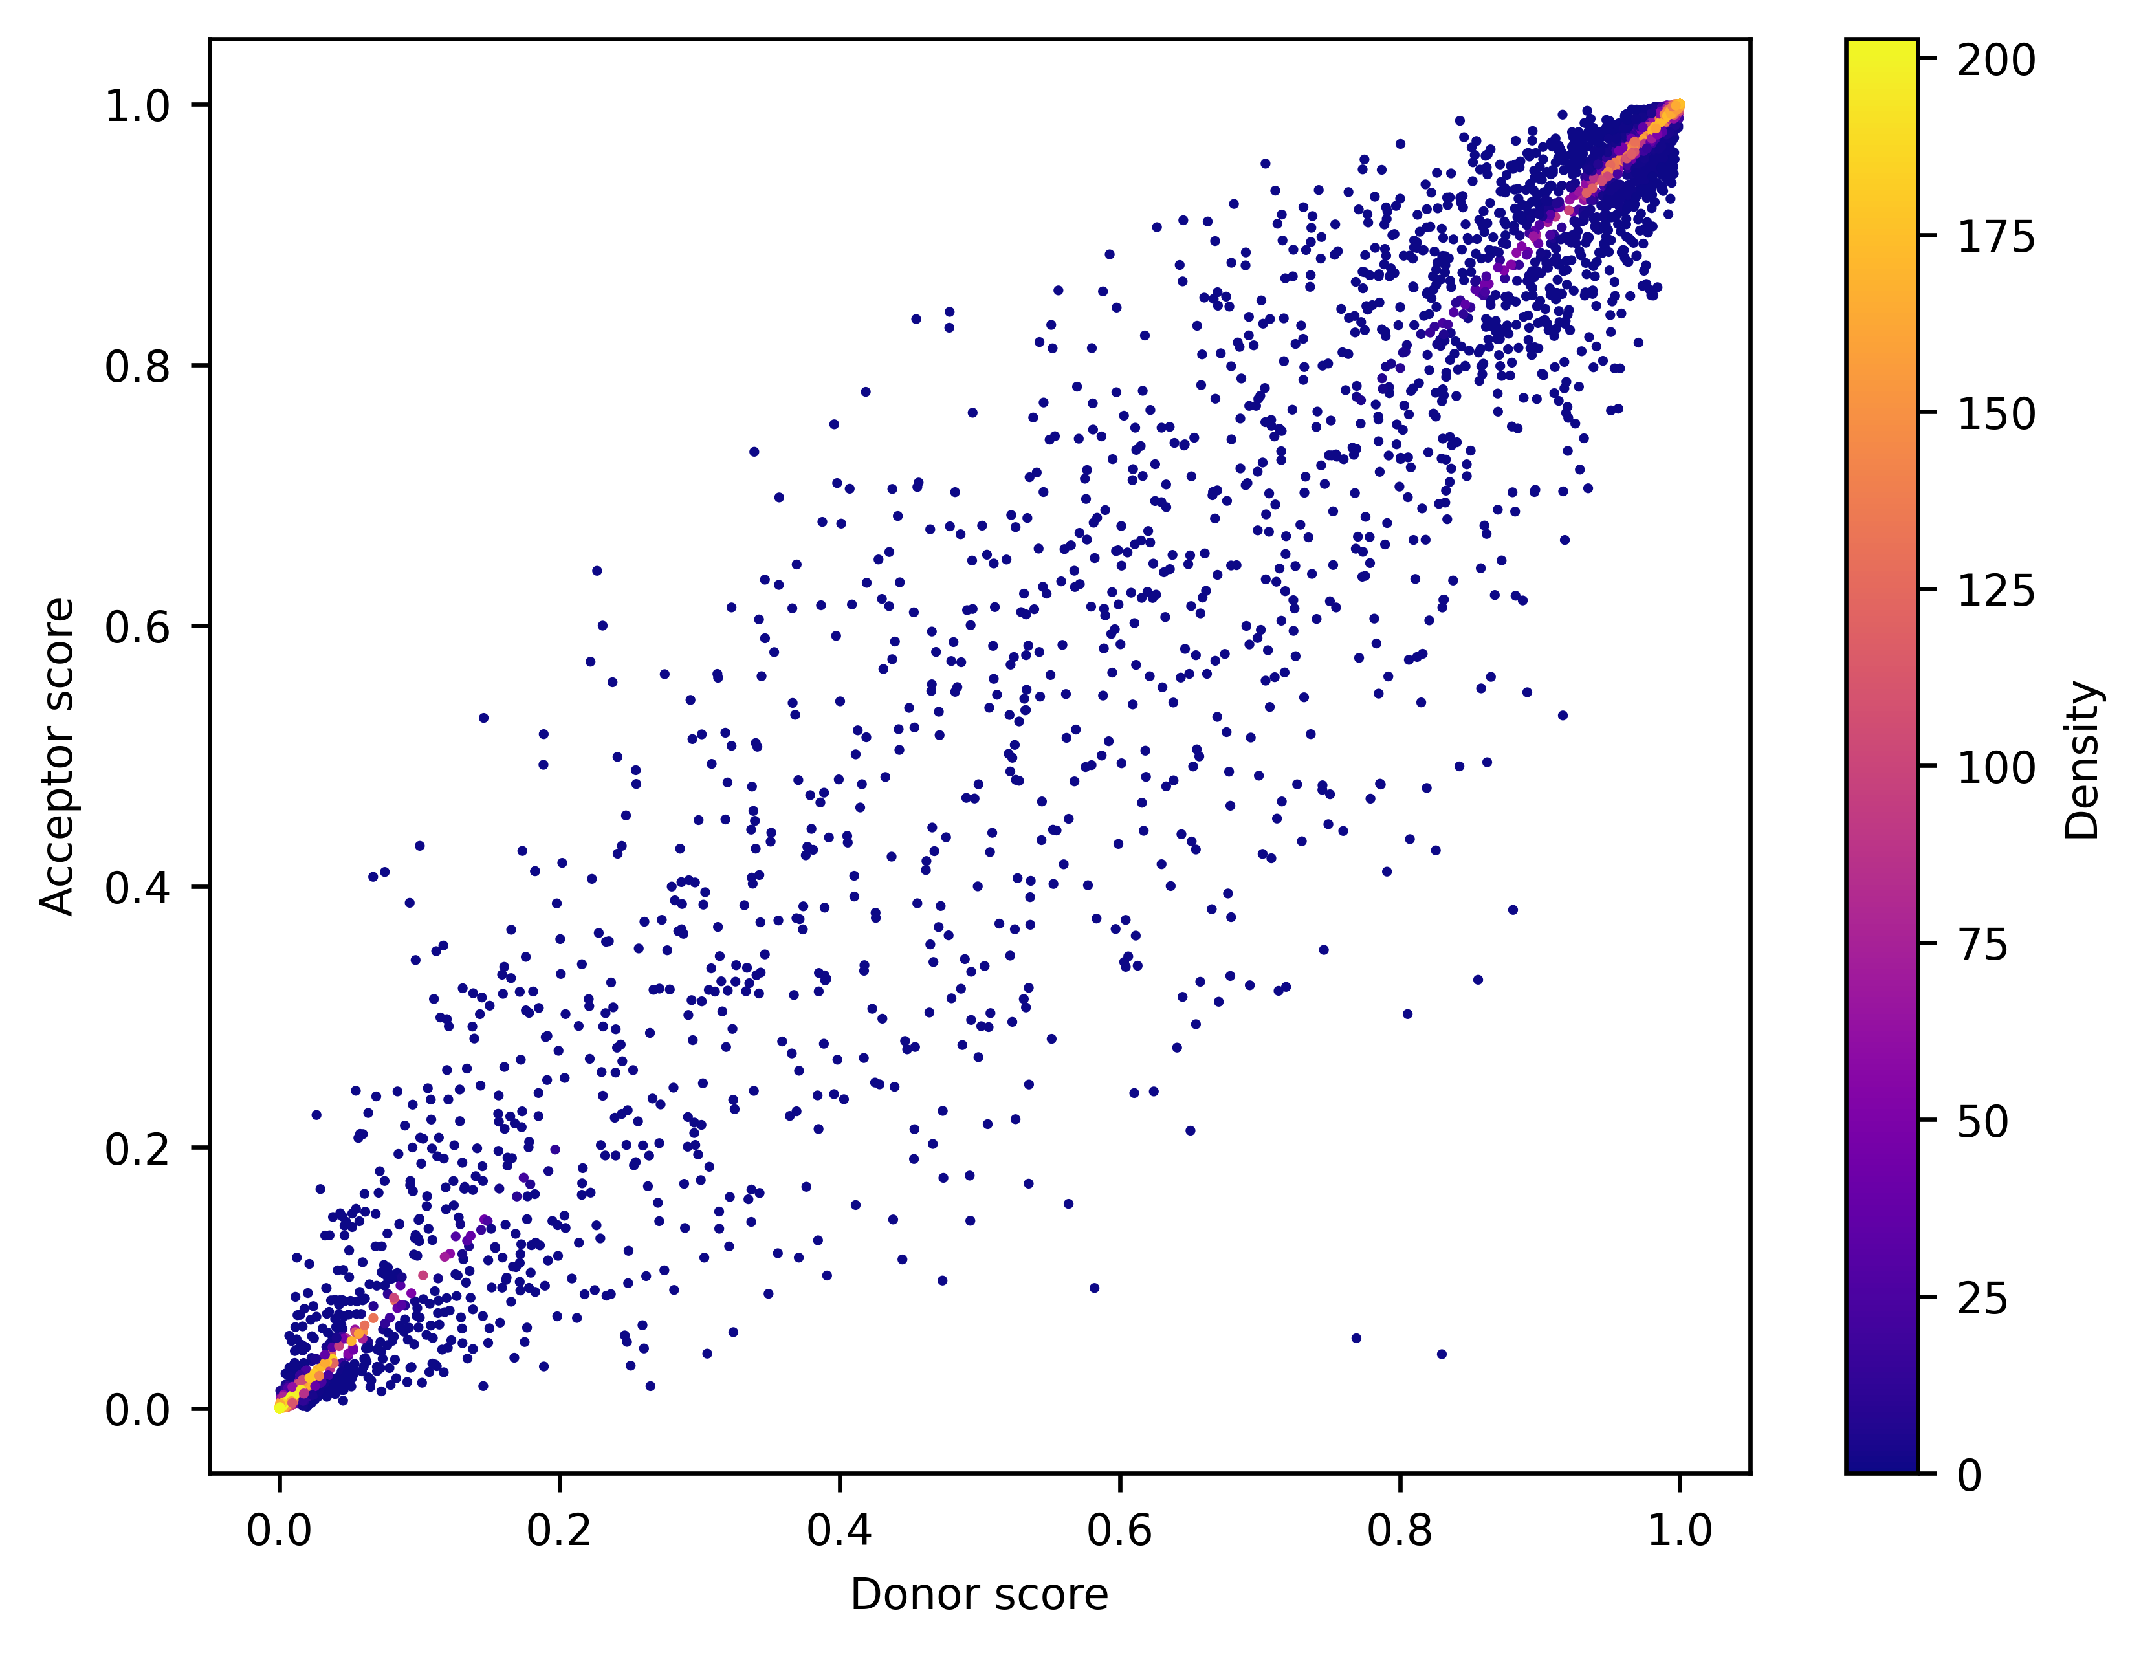
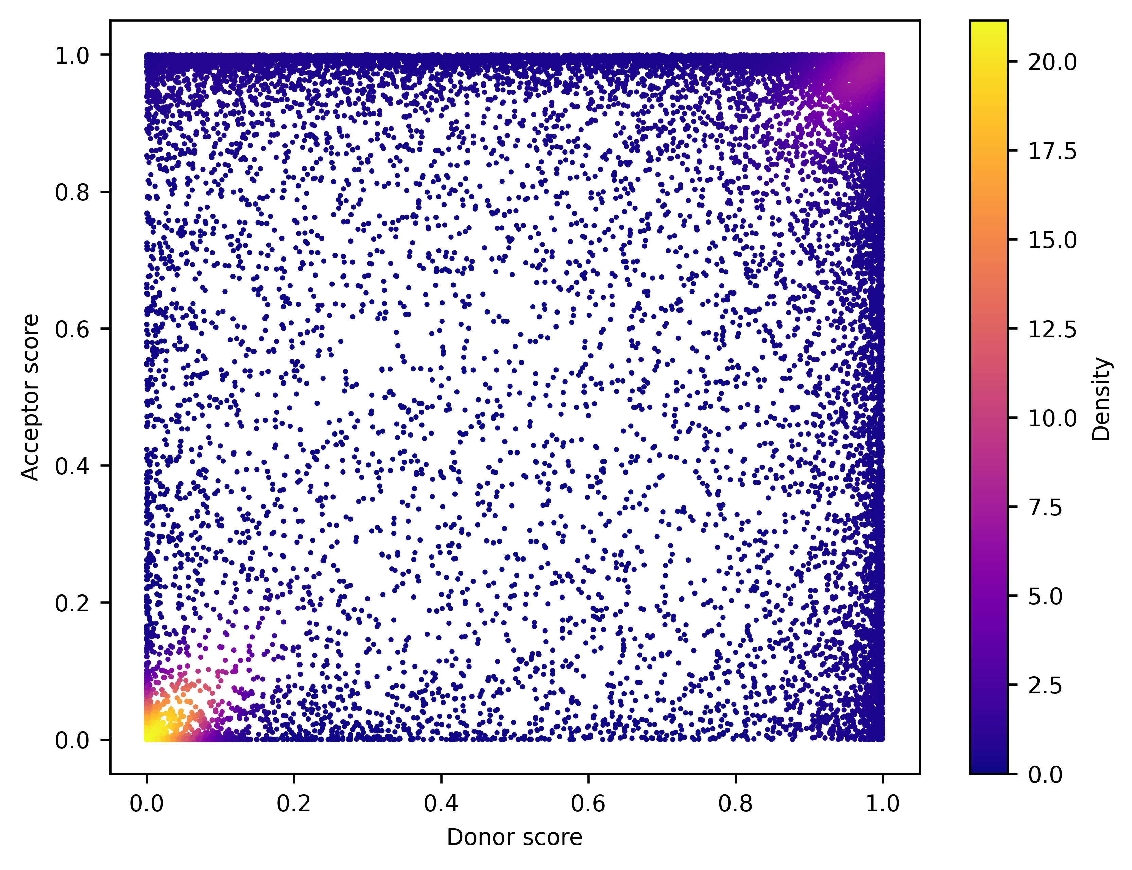
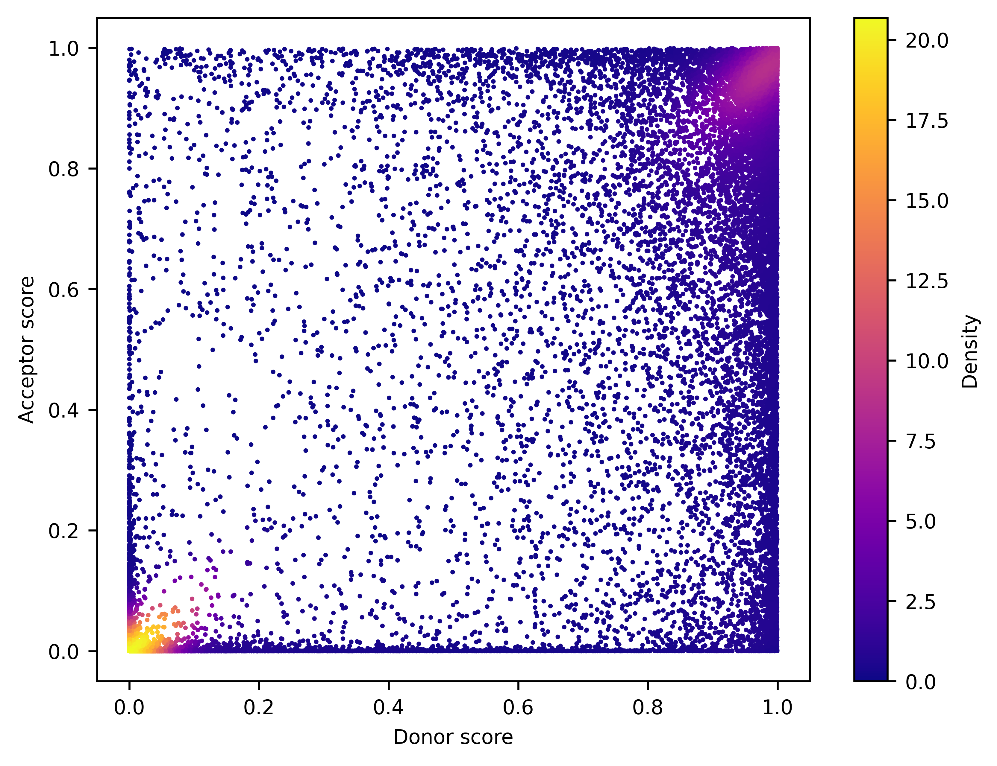
Positive_ALT
SPLAM
Positive_MANE
SpliceAI-10k
SpliceAI-10k-Ns

